Slide 1
Predict Dengue Fever Using Machine Learning
Approach
Supervisor: Dr.Qanita Bani Baker
By:Dalya & alAnood

Slide 2
Outlines:
Introduction
Methodology
Submissions
Conclusion
Future work

Slide 3
Introduction
Dengue fever is a deadly viral disease transmitted by mosquitoes. Upon infection, the patients would show fever, rash, and muscle and joint pain. In severe cases, it could cause severe bleeding, low blood pressure, and even death.
This fever is closely related to the weather; therefore it is widespread in regions with tropical and semi-tropical climates throughout the world, including Latin America and some Asian countries.
The climatic conditions that are considered as one of the main influences in dengue fever are temperature, rainfall, and humidity levels.

Slide 4
Aims of the study
This paper aims to ”predict the number of cases of dengue fever in the week” in two cities Iquitos, Peru and San Juan, Puerto Rico.
Using five models of machine learning, multiple linear regression, neural network, random forest(RF), negative binomial model (NBM)and poisson regression model(PRM).
We will compare the results that we will get from applying these five models with the results of other research and we will try to reduce the error rate between the real value and the predicted values by using mean absolute error

Slide 5
Why did we use machine learning?
With having enough historical data related to the dengue disease and the climate changes, it invites the question of whether it is possible to use the correlation of the data to predict an epidemic before it happens.
Machine Learning is an efficient way of predicting the future disease outbreaks by analyzing the past data and correlating them with climate changes.

Slide 6
Our Methodology
Data Set
Data Analysis
Data Preprocessing
Model Selection
Evaluation

Slide 7
Dataset
The dataset consists of climate data and the total number of reported dengue patients in a weekly timescale .
data could be found in [1]
The dataset consists of 1456 records and 24 features divided into five main categories
Location
Temperature
Precipitation
Humidity
Vegetation

Slide 8
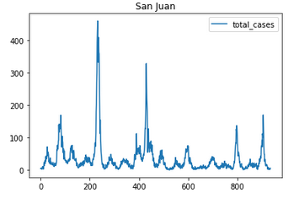
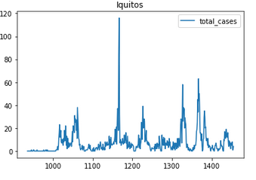
Data Analysis
San Juan
Iquitos

Slide 9
Data Preprocessing
Handle missing value and outliers (548 missing values)
In San Juan most missing values were Vegetation
while in the Iquitos dataset most missing values were temperatures
Normalization for dataset
min-max normalization

Slide 10
Model Selection
1 Multiple Linear Regression (MLR)
2 Random Forest(RF)
3 Negative Binomial model (NBM)
4 Poisson Regress model
5 Neural Network (NN)
6 bagging with decision tree

Slide 11
Model Selection
7 Naive Bayes (NB)
8 AdaBoost
9 Decision tree(DT)
10 Support vector machine(SVM)
11 K-nearest neighbors algorithm (KNN)
12 Ensemble(RF,NB,DT,SVM)

Slide 12
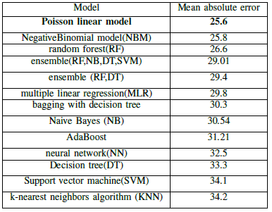
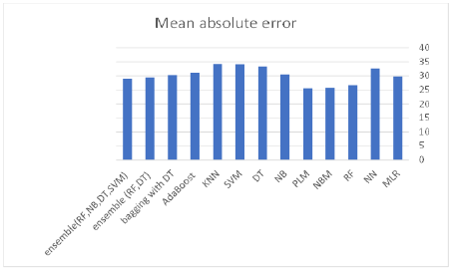
Evaluation

Slide 13
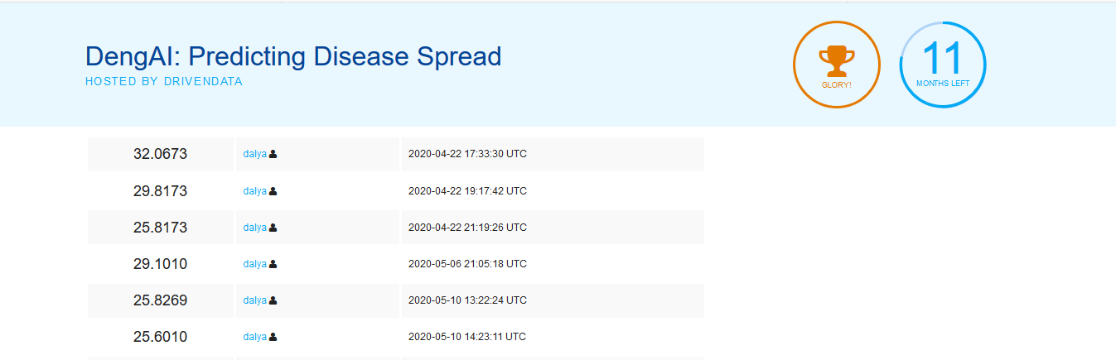
Submissions

Slide 14
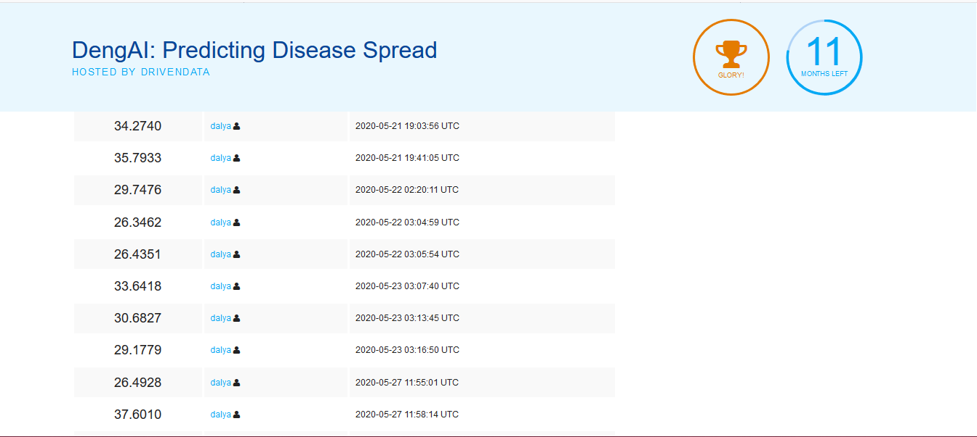
Submissions

Slide 15
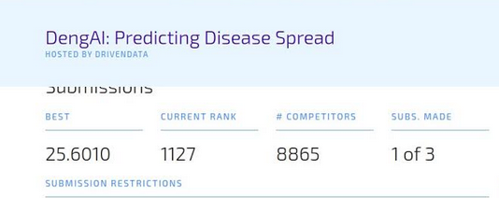
Best Submission

Slide 16
Conclusion
Data preprocessing has a huge impact on the results of machine learning algorithms
Data conversion and normalization is required for more accurate predictions
Obtain the lowest percentage of error after the process of separating the data set.
The Poisson Regress model obtained the lowest error ratio by 25.6.

Slide 17
Future work
In the future, we can work to increase the size of the data set by obtaining a recent data set from the World Weather Organization and applying a greater number of machine learning models. Deep learning can also be applied, given that the size of the data set will be increased and become applicable by deep learning.

Slide 18
References
[1] https://www.drivendata.org/competitions/44/dengai-predicting-disease-spread/data/

